Slide 1

Board of Directors Retreat
Maggie Bailey, PhD Business (USC), MBA (UC Berkeley)
mbaileyconsulting@gmail.com
P.O. Box 892620, temecula, California 92589
(951) 757-5678

Slide 2
Dr. Maggie Bailey is President, Pacific Educational Resources. She has 30 years of experience in higher education including Provost, St. Katherine College; Vice Provost, Point Loma Nazarene University (PLNU); and business professor at several Southern California universities. She was the founder and Director of the PLNU Center for International Development.
Dr. Bailey’s areas of expertise include finance, strategy, economics, and international development. She earned her doctorate in business strategy at the University of Southern California and master’s degree in business policy, finance, economics at the University of California, Berkeley. Her passion is business development in marginalized communities.
Before her academic career, she was a financial analyst for the Southern California Edison Corporation and served 11 years as an officer in the United States Navy. During her service in the Navy she was assigned to the Commander-in-Chief of the U.S. Pacific Fleet, followed by a tour of duty in the Pentagon on the personal staff of the Chief of Naval Operations, and then attached to the U.S. Senate as a military adviser. During Gulf War I she was recalled to active duty as a Commander and deployed with the Military Sealift Command in Yokohama, Japan.
Dr. Bailey has served on several non-profit boards. She lives in Temecula, California with her husband David who is a retired US Marine and Riverside Deputy Sheriff. They have an adult son, Justin, and daughter, Jeanie.

Slide 3
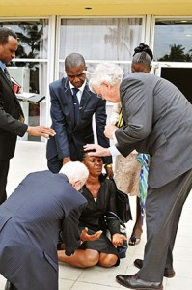
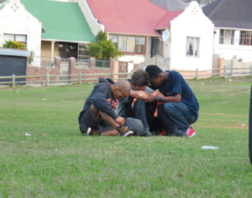
SESSION 1
BOARD RECRUITMENT, ON-BOARDING, AND EXPECTATIONS

Slide 4

Ministry leadership check-up….
Board of Directors
Executive leadership
Ministry directors

Slide 5
Role of the Board of Directors
Boards are responsible for their attendance, discipline, governance methods, development, agendas, and ability to envision the future. Others can help. Surely the CEO should even be required to help. Helpers, however, can only assist a body that has assumed full responsibility for itself…..
          - John Carver, Boards that Make a Difference, 3rd edition, 2006, p 190

Slide 6
What are the differences between board governance and management’s roles?
Board's Roles
Management's Roles
Select, evaluate and support the CEO
Approve high level strategic goals and corporate policies
Make major strategic decisions
Fiduciary responsibility including budget and financial oversight
Oversee organizational performance
Act as external advocates and diplomats in public policy, fundraising and stakeholder relations
Run the organization, within board-set parameters
Recommend policies, goals, investments supported by background information
Frame decisions, bring well-documented recommendations
Provide timely, transparent information
Mobilize directors to leverage their external connections
Source: Distinguishing Governance from Management, Barry S. Bader, Great Boards Fall 2008 Vol. VIII No. 3

Slide 7
Governance roles of a board member
Fiduciary Role
  Good faith, loyalty, and care
  Executive Relations (oversee and support President/CEO, plan for succession)
  Financial oversight including budget and audit review and approval
Strategic Role
  Embody a commitment to the Mission, Vision, Values in decisions and actions
  Major strategic priorities and goals aligned to mission, vision, values
Generative Role
  Proactively perceiving and discerning trends and big issues
  Envisioning alternatives to the present

Slide 8
Basic Responsibilities of a Non-Profit Board
Determine and protect the organization’s mission and purpose
Select the chief executive and succession planning
Provide proper financial oversight
Ensure adequate resources
Ensure legal and ethical integrity and maintain accountability
Ensure effective organizational planning
Recruit and orient new board members and assess board performance
Enhance the organization’s public standing
Determine, monitor, and strengthen the organization’s programs & services
Support the chief executive and assess his or her performance
Source: The Nonprofit Board, Board Source (2nd edition, 2007) p. 3-4

Slide 9

Board members:
Wisdom, works, wealth and web

Slide 10
Does your ministry have the right combination of people in key decision-making roles?
What are the two or three most critical requirements for leadership, given the ministry’s expected challenges and future opportunities?
What are the two or three most distinctive talents required of the leadership team over the next decade? Are they staying current on changes in national standards, international ministry context and technology?
Is there a convergence between the several criteria that best define a strategic match between the financial leadership requirements and the ministry’s capabilities at a given moment?
Does the Board have strong leadership that can support the strategic and financial ministry team and mission.
Do board members have potential conflicts of interests (e.g. relatives, contractors, employees, related entity, etc.)

Slide 11
Creating a Board Profile
Board Competencies
Skills and Experience
  Ministry knowledge
  Financial expertise
  Fund development
  Marketing
  President/ Executive experience
Individual Attributes
  Independence
  Business acumen
  Ministry Teamwork
  Public reputation/ speaking
  Deep spiritual life
  Impeccable reputation
Representational Factors
  Geographical
  Gender, ethnic, and racial diversity
  International
  Donor knowledge
  Age demographic (e.g. millennial)
  What kinds of experience and expertise will enable the board to ask the right questions and engage in informed discussions as it tackles the strategic issues the ministry is likely to face over the next decade?

Slide 12

Board of Directors Profile Exercise

Slide 13

Board Member Self-Evaluation
Exercise: Board Member Self-Evaluation

Slide 14
Board and Management Expectations
Management expectations of the board
Board expectations of management
Desired climate and culture of the board
Working relationship between the board and management

Slide 15
Board and Management Expectations
What the Chair of the Board Expects from the Board members
Preparation for the board meetings
Effective engagement at board meetings and active committee service
Participation and support of the ministry throughout the board members time of service
Mutual respect and constructive participation
A healthy culture including strict confidentiality, no conflicts of interest, no unhealthy alliances and no surprises
External relations serving as an ambassador for the ministry
Financial and resource commitment

Slide 16
Board resources
Board packet (distributed at least one week before the board meeting)
1. Board minutes
2. Board terms rotation schedule
3. Ministry financial reports and analysis
4. Agenda with mission, care values, and strategic priorities
5. Committee reports and documents
6. Board roster, Board meeting schedule (2 years minimum)
7. Audit report, IRS 990
8. Annual: Conflict of interest, ethics, mission/values/ strategy, statement of faith
9. Key Performance Indicators (KPI), Dashboard
Board Orientation binder (on-boarding)
1. Welcome letter from Chair
2. Bylaws and other governance legal documents
3. Board job description, evaluation forms
4. History and key background documents (mission/ values/ strategic plan)
5. Board member bios and contact information
6. Annual documents: Conflict of interest, ethics, confidentiality, mission/ values/ strategy, statement of faith
7. Financials and recent audit with the management letter
8. Committee descriptions & assignments
9. Organizational chart with names

Slide 17
SESSION 2: Board decision-making and Committee structure
  Strategic role of the board
  Role of the Committees
  Finance Committee and board financial decision-making
  Board metrics and outcomes
  Role of assessment: Self, Chair, Members, and Chief Executive

Slide 18
Reflection on Fiduciary Issues
What are the fiduciary roles of the board and committees?
How do we know the organization is fulfilling its mission?
Does the Board consider each new initiative in line with the mission and strategic priorities ?
What safeguards do we have in place to avoid well-publicized fiduciary failure?
If we held an annual stakeholders’ meeting, what would we say about organization’s fiduciary performance and the board’s effectiveness as a steward?
  (Governance as Leadership: Reframing the Work of the Nonprofit Boards, Richard Chait, William Ryan, Barbara Taylor, 2008, p 48)

Slide 19
Reflection on Fiduciary Issues
What is the evidence that we are a trustworthy organization? What are some examples of times when we earned the title of “trustworthy?”
What are our major financial vulnerabilities? What are we doing as an organization and a board to address them?
Even though we are not obligated to abide by Sarbanes-Oxley and similar legislation, should we voluntarily adopt certain principles and practices these laws require? Transparency
  (Governance as Leadership: Reframing the Work of the Nonprofit Boards, Richard Chait, William Ryan, Barbara Taylor, 2008, p 48)

Slide 20
Strategic Role of the Board
The Board sets the direction for the organization; on the basis of that direction, the staff fleshes out the plan, defines the strategies to achieve the plan, and determines the operational objectives. Undertaking the process of strategic planning offers numerous benefits to a nonprofit organization.
It maintains a mission-based focus
It sets the strategic priorities for a period of time and reviews the appropriateness of the targets and assigned responsibility
It offers a “reality check” for allocating resources
It provides a performance review and CEO/President’s strategic leadership
It builds consensus and ownership
It helps define leadership characteristics

Slide 21
Is your ministry Board providing strategic guidance and strong oversight?
Does the board understand the ministry sector and bring value to the ministry in terms of experience, insight, vision, and guidance.
Does the board have a strong team that has years of experience in developing a strategic planning process, guidelines and communication?
Is the budget aligned with the strategic priorities of the ministry?
Are the financial margins and reserves sufficient to allow the ministry to take advantage of new opportunities?
Does the board receive support and collaboration from the ministry staff?
Does the board understand the risk profile of the ministry?
Are there ethical safeguards in place to protect the ministry.
Do you have the right auditors? Does the ministry periodically review the auditors and require an RFP.

Slide 22

Board Committee Structure
Board committees should work at the board’s level, not below it. With respect to policymaking, the contribution a committee can make is to prepare board-level policy issues for board deliberation. John Carver, Boards that Make a Difference, p. 226
Audit Committee
Finance Committee
Governance Committee
Executive Committee
Investment and Asset Committee
Development/ Advancement Committee
Membership Committee

Slide 23


Financial Decision-Making

Slide 24
Board Financial Decision-Making
The Board must ensure that the ministry maintains:
Accurate and up-to-date financial records
Prepares and follows an annual budget
Prepares accurate and timely financial statements
Financial policies and asset management policy including investment policy
Complies with federal, state, and local regulations and applicable reporting requirements (IRS 990)
Conducts an annual external financial audit
Internal controls and ensures segregation of duties
Effectively manages risk (e.g. insurance, conflict-of-interest, financial management)

Slide 25
Does your Board have frequent updates with the right metrics for decision-making flexibility?
What are the ministry Key Performance Indicators (KPIs)? Are these aligned with the strategic priorities of the ministry?
Does the ministry use dashboards and provide the Board regular updates? Are these the best metrics?
Is the ministry able to disaggregate data in a way that improves decision-making?
Does the ministry have a continuous improvement culture and work collaboratively with stakeholders?
Is budget preparation collaborative and lead to strategic conversations?
Is the ministry risk-profile frequently updated and reviewed? Are there opportunities to reduce risk?
Does the CEO/President communicate frequently with the board on progress of the ministry meeting the strategic priorities, budget targets, and ministry successes and challenges?

Slide 26
Financial Metrics
Key Performance Indicators (examples)
Income and expense actuals and projections
Donor and grant growth rate year-over-year
Donation growth
Average gift size growth
Donor retention rate
Fundraising ROI
Recurring gift percentage
Social media engagement
Online gift percentage
Pledge fulfillment percentage
Dashboard
Successful dashboards do the following:
Effectively communicate strategic-level results;
Present data in a user-friendly visual format;
Create a snapshot of current status as well as trends over time;
Clearly show performance against defined targets;
Highlight out-of-the-ordinary results; and
Include a manageable set of key performance indicators (KPIs).

Slide 27
When should a ministry use expert consultants?
When a ministry benefits from a consultant:
  Expertise
  Objectivity
  Less expensive to outsource than to hire internal expertise
  Accountability
  Transparency
Carefully define in the contract the expectations and limitations of the consulting services
Be wary of long term entanglements

Slide 28
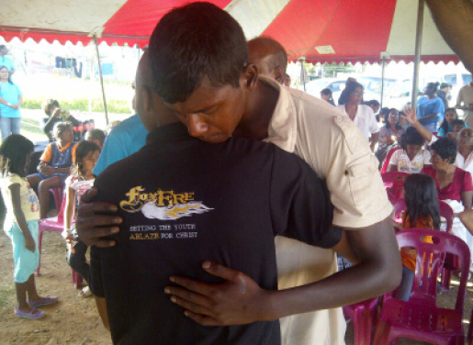
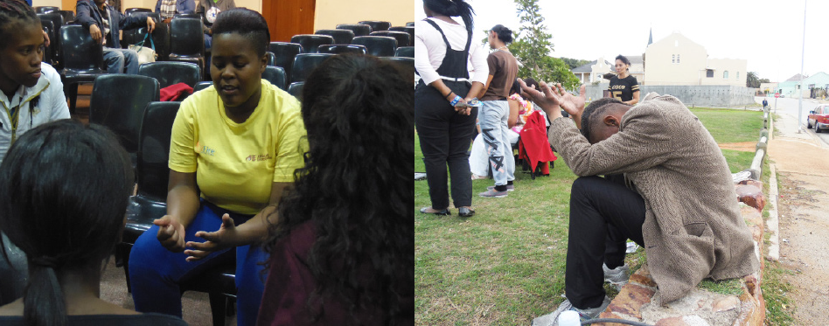
Board performance and evaluation

Slide 29
Board evaluation (sample forms)
CEO annual performance evaluation
Board performance evaluation
Board evaluation of the Chair leadership
Board member’s self-evaluation

Slide 30
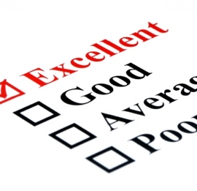
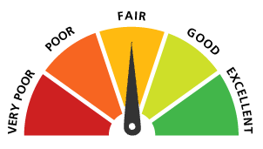
Building a Governance Scorecard
Caryn Ryan, Founder and Managing Member, Missionwell LLC
Dr. Margaret Bailey, President, pacific educational resources
Property of Missionwell LLC and M Bailey Consulting. Reproduction and further distribution require permission.

Slide 31

Session Description
What we measure, improves!
The focus of scorecards has been to gauge management effectiveness and operational efficiencies; they can also be used to gauge board governance effectiveness.

Slide 32
The Board governance performance framework is from 3 key sources of research
The Performance Imperative
  A Framework for Social Service Excellence: Seven pillars of excellence developed collaboratively, Results Leadership Group, 2015
Balanced Scorecards
  Body of work by R. S. Kaplan, David P. Norton and many others, and traditionally a management tool for strategic execution and results.
The Effective Board of Trustees
  A book by R. P. Chait, T. P. Holland & B. E. Taylor who jointly researched what distinguished highly effective from ineffective boards.

Slide 33
The Performance Imperative
High performance is the ability to deliver-over a prolonged period of time—meaningful, measurable and financially sustainable results for the people or causes the organization is in existence to serve.

Slide 34
Balanced scorecard measures: move from observation to KPIs
Observation
Observe, for instance, a process. See points of raw data.
Quantification
Mapping the observations into numbers, e.g. units of something
Measurement
Concrete attributes, e.g., total amount of something
Metric
KPI
Derivative, possibly normative, abstract or relative
Ties to mission, performance-oriented
Development office example:
Contacts, donors, contributions,
funds delivered to field

Slide 35
Putting it all together
Six Performance Areas
Courageous & Adaptive Leadership
Strategic Focus
Beneficiaries & Stakeholders
Internal Relationships
Learning & Growth
Financial Health
Board Governance Questionnaire
Determine where your board is strongest and where you have opportunities for growth
Board Governance Scorecard
Watch your board grow in the areas you select (and probably others)

Slide 36
Board Scorecard Framework
Six performance areas for effectiveness
Strategic Focus
Financial Health
Beneficiaries &
Stakeholders
Courageous Adaptive Leadership
Learning & Growth
Internal Relationships

Slide 37
Courageous, Adaptive Leadership is foundational
What does it mean?
Board embraces their responsibility to deliver meaningful, measurable and financially sustainable results. Strong, knowledgeable, committed directors and stewards over resources and ethical performance.
Sample goals/objectives:
Improve quality of decision making by adding 2 more diverse directors with strong leadership, needed skills and potential network
Increase content of strategic (vs. administrative) topics in board agenda

Slide 38
Courageous, Adaptive Leadership
Possible Metrics
Presence at meetings: % Attendance
Preparedness: % Read Pre-read, advance questions
Engagement: No one or more person(s) dominated meeting
% Agenda devoted to open discussion of strategic issues and opportunities
% Directors electing to stay on for maximum term
Board approved strategic plan (Y/N)
Opportunities for inclusionary fellowship of board members exist (Y/N)
% Diversity, e.g., ethnic, gender, age, racial
Board member evaluation process (Y/N)
Full board effectiveness evaluation process (Y/N)
Balanced expertise and skills (Y/N)
Board meeting effectiveness anonymous feedback (Y/N)

Slide 39
Strategic Focus: Playing the generative role intentionally creates the future
What does it mean?
A board is strategically focused when its helping to envision and shape institutional direction and helping to ensure a strategic approach to the organization’s future.
Sample goals/objectives:
Move board discussions to direction-shaping and away from operational concerns.
Improve the reliability, objectivity and transparency of the information coming to the board.

Slide 40
Strategic Focus: Possible Metrics
Board expresses its priorities in writing (Y/N)
% of agenda spent on agreed board priorities
% of directors agreeing that sufficient time is allowed for generative discussions
% of directors agreeing that pre-reads by staff or consultants are objective and fact based
% of directors agreeing that pre-reads by staff or consultants tie to issues important for mission achievement
% of KPIs aligned to strategic priorities
% of directors agreeing that board’s information allows them to understand issues and discuss appropriately

Slide 41
Beneficiaries and Stakeholders
Who are they?
Beneficiaries
  Target recipients of your programs and services
  The community of the beneficiaries
Stakeholders
  Partner organizations
  Volunteers
  Rule makers (e.g., politicians) and news makers [national & international]
  Grant makers
  Watchdogs and regulators
  General public

Slide 42
Beneficiaries and Stakeholders
Sample goals/objectives
Increased beneficiary satisfaction
Improved understanding of needs of those using the services
There is a clear and measurable vision for impact of our products and services on beneficiaries.
We’re sure our desired impact for beneficiaries matches what they want.
We’re informed of the impact on beneficiaries once they leave our support system

Slide 43
Beneficiaries and Stakeholders
Possible metrics
% of board members believing suite of impact measures/metrics are adequate, vs. target
Executive scorecard (as shared with board) includes outcomes and impact measures that board sets as relevant
Board schedule/calendar allows sufficient opportunities for stakeholder engagement (Yes/No)
Total interactions with beneficiaries by board members, e.g., attendance at organization programs and activities, open Q&A time, etc.
Average number of interactions per board member vs. target
Major donor/grantor giving to programs designed by organization to deliver impact, vs. target, % or $

Slide 44
High performing boards attend to
Internal Relationships
What does it mean?
Nurtures the development of directors as a group, attends to the board’s collective welfare, and fosters a sense of cohesiveness
Strong supportive relationship with Executive fostering sense of partnership, personal care and the optimal blend of advice/counsel
Robust system to manage internal relationships including Board and Executive development, training and assessment

Slide 45
Internal Relationships
Sample goals/objectives
Get the board culture healthier, more respectful, collaborative, and ethical
Ensure every board member is heard over the course of a meeting
Relationships are strong enough both to allow conflict and bring it to healthy resolution
Change conversation dynamics from mainly staff-board to board – board
Develop next generation of Board and Executive leaders
Senior leadership/Executive can express value the board brings to the table

Slide 46
Internal Relationships
Possible Metrics
Executive
Board
Voluntary turnover rate
Length of service
Succession plans exist for Executive and key organization leaders
% of directors confident in succession plans
Executive has annual goals set by board (Y/N)
Executive has annual perform. review (Y/N)
Executive compensation benchmarked by board vs. organization standards and relevant external data
Voluntary turnover rate
Scores on periodic anonymous survey of inclusiveness
Existence of distinct board goals (Y/N)
% of board members that can express distinct board goal
% agreeing board goals assist
Succession plans exist for key board leadership roles

Slide 47
A passion for Learning and Growth tied to mission success drives performance
What does it mean?
Its not learning for the sake of learning, but for the sake of driving mission success. This area supports all the other areas.
Sample goals/priorities:
Staff and guests are specifically invited to meetings based on our board’s need to learn new information
We will intensively learn about __(quantity)___ competing or partnering organization(s) per __(time period)___
We will identify our information gaps

Slide 48
Learning and Growth
Possible Metrics
Benchmarked X (peer/aspirant) organizations
Board has learning agenda (Y/N)
% directors agreeing that board accesses relevant new information giving impetus to advancing mission in new and better ways
% of directors agreeing board learns and adapts from past performance
% directors agreeing that board carves out the time to be reflective
% directors agreeing that board scorecard is moving the board to higher performance

Slide 49
Financial Health
What it means
Financial health is having the resources available to sustain the mission, and grow it as appropriate, take appropriate risks and weather the occasional storms. This means more often than not creating a surplus operationally.
Sample goals/priorities:
Tie budget process to strategic plan to better align organization.
Create a six month operating reserve.
Create relationships with X donors/grantors over Y period.
Develop financial policies and procedures.
Add X board members with financial/strategic competencies.

Slide 50
Financial Health
Possible Metrics
Income (revenue, expense) vs. budget
“Same store” Year-Over-Year revenue
Operating reserves vs. target
Unrestricted assets vs. target
Earned vs. contributed revenue
Functional expense ratios
Positive income and cash (excluding planned investment goals)
Debt ratios
Infrastructure goals (if you are in infancy-adolescence phase of life cycle)
Board giving vs. goal
Control breakdowns
Existence of sufficient financial expertise on board (Y/N)
Board policy on public transparency of financial info (Y/N)

Slide 51
Steps to Developing Your Board Scorecard
Score board in six performance areas of Board Governance Questionnaire
    Use insights to select the performance areas you want to focus on
Set a goal for the performance areas you select
    Change the goal as needed, once out of date, or to set the bar to a new place
Pick 1 to 3 good measures for each performance area selected
      Objective
      Inexpensive to collect relative to value
      Targeting the things most important to success and performance
      Changes in score, even small ones, will be meaningful

Slide 52
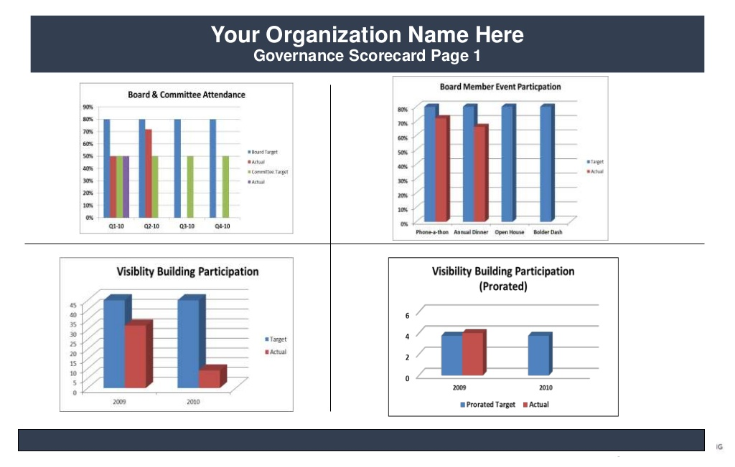

Slide 53
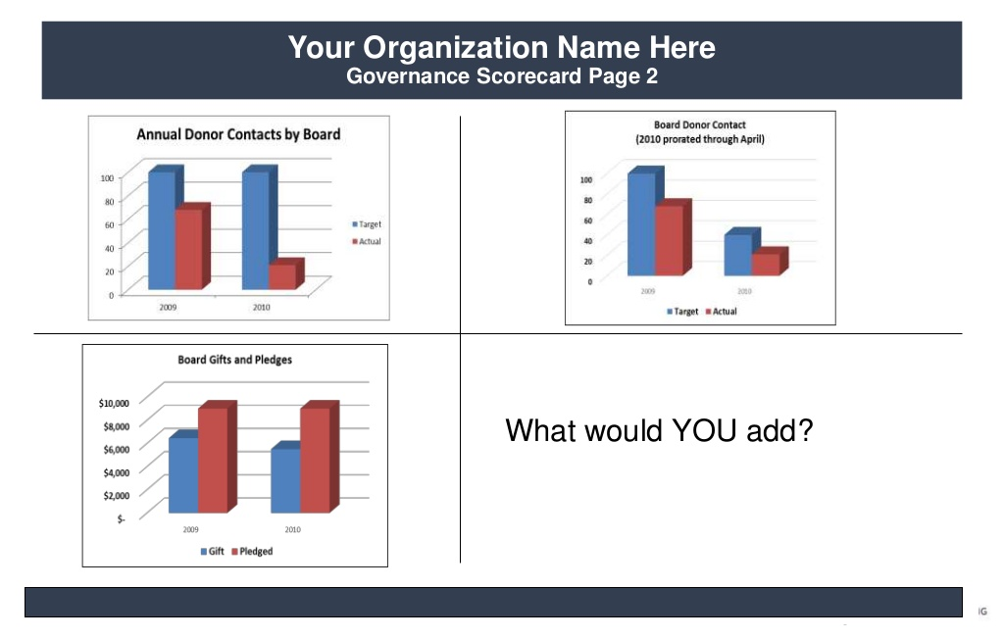

Slide 54

Board members are prayer partners

Slide 55
SESSION 4
Strategic Priorities, objectives, & measures
DEFINITION: Strategy is the plan non-profit management is using to define its mission, core values, priorities and value proposition, conduct its operations, attract and engage stakeholders, be financially sustainable, and achieve organizational objectives.
KEYS TO SUCCESSFUL STRATEGY
Good strategy design and execution are the most trustworthy signs of good management and strong leadership.
Build donor awareness strong enough and an organization capable enough to produce successful performance despite unforeseeable events, potent competition, a rash of delays, or cost surprise.

Slide 56
TASKS OF STRATEGIC PLANNING
Develop a strategic vision, mission and core values
Set strategic priorities that will focus resources and personnel
Analyze internal strengths and weaknesses & external threat and opportunity
Set clear and measurable targets with Key Performance Indicators (KPIs)
Craft a strategic pathway to achieve ministry vision, mission, and strategic priorities
Identify gaps between current and desired performance
Communicate strategy and develop operational plans
Continuous assessment, analysis, and improvement of strategy for implementation and execution
Evaluate performance, monitor new developments, and initiate corrective adjustments

Slide 57
CRAFTING A STRATEGY
Mission: Deliberate and purposeful actions
Situation Analysis: Start with the data, analysis and implications to construct a current profile
External Threats & Opportunities: Identify external pressures and as-needed reactions to unanticipated developments and novel environmental conditions and opportunities
Strengths & Weaknesses: The collective learning of the organization over time—not just the insights gained from its experiences but, more important, the internal activities it has learned to perform quite well and the competitive capabilities it has developed
Choosing Strategic Pathway: The strategy-making task thus involves developing an intended strategy; adapting it as events unfold (adaptive/reactive strategy) and linking the organization’s approaches, actions, and competitive initiatives closely to its competencies and capabilities
Selecting and Monitoring Strategic Metrics: Develop Key Performance Indicators, metrics, dashboards to monitor progress, assess performance, and continuous improvement adjustments

Slide 58
Ministry analysis of current capabilities is the starting point
How well is the ministry’s present strategy working and how do we know (data)?
What are the ministry’s resource strengths and weaknesses?
Are the ministry’s donor message and relationships compelling?
How strong is the ministry’s donor profile and message (direct mail, electronic, major donor, events, etc.)?
What strategic issues does the ministry face? What is the risk profile?

Slide 59
Defining the Mission
WE EXIST TO (brainstorming session):
Provide resources so AE field operations to fulfill the mission
Engage American Christians with the message and story of the African Christian
Mobilize the body of Christ to pray for the African nations and believers
Development base for AE
Prepare free church for persecution
Speak out for African church
Advocacy
Connect people to people; put a face on African believer

Slide 60

Equipping ministries to be effective Kingdom builders
BLESSINGS FOR THE JOURNEY

