Slide 1
Association of Nazarene Educational Systems Asia-Pacific Region Educators’ Roundtable Manila, Philippines 8-12 February 2016 Global Education and Clergy Development Dr. Dan Copp Education Commissioner Global Clergy Development Director dcopp@nazarene.org

Slide 2
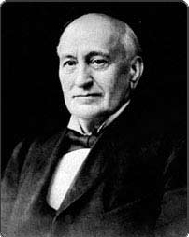
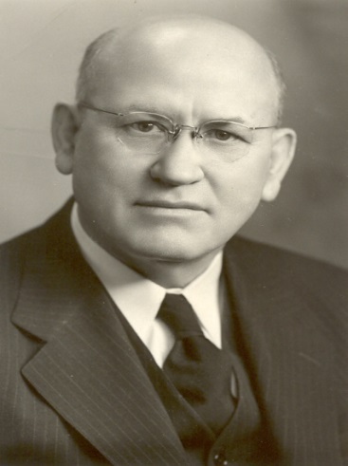
From the beginning… Central to the Church of the Nazarene Mission
Nazarene Higher Education
“We believe in all branches of knowledge. God helping us,
we propose to teach men and women that they may be
at their best advantage for God.” P.F. Bresee
Nazarene Clergy Development
“More and better preachers… there is a demand
for quantity… but with the quantity there must
be a stepping up of the quality or we shall yet
become a cult, rather than a rounded brand of
the Church Universal.” J.B. Chapman

Slide 3
The late Dr. John A. Knight often stated,
“Holiness, missions, and education
are the hallmarks of who we are.”
“Santidad, misiones y educacion son
las caracteristicas mas importantes de quienes somos.”
"Santidade, missões e educação são
as principais características de quem nós somos".
"La sainteté, la mission et l'éducation sont
les caractéristiques de notre identité."
"성결과 선교, 그리고 교육은 우리의 정체성의 표시입니다."
Notes:
3

Slide 4
Global Education and Clergy Development Committee of the General Board “give oversight to the global educational enterprise, IBOE, clergy preparation, clergy development, and other such interests related to education and ministry.” (2009 BGS White Paper) “shall have policy oversight for the International Board of Education, Clergy Development, and for other matters assigned by the General Board.” (2014 General Board Policy Manual)

Slide 5
Global Education and Clergy Development Global Clergy Development (GCD)
International
Board
Of
Education
(IBOE)

Slide 6
Regional Education Coordinators
Africa – Greg Crofford
Asia-Pacific – John Moore
Eurasia – John Haines
Mesoamerica – Ruben Fernandez
South America – Jorge Julca
USA/Canada – Dean Blevins
Global Ministry Center Staff
IBOE GCD
Tammy Condon Stan Rodes
Barb Najarian Frances Reyes
Dana Porter Darlene Friend
Dan Copp
Education Commissioner
Global Clergy Development Director

Slide 7
BGS / General Board
Regional Education Coordinators,
ICOSAC, RCOSACs
Regional Education Coordinators,
IBOE, Regional Councils
Global Nazarene
Education Consortium
(GNEC)
Quality & Missional
Reviews,
Board Development
Calling of Clergy
International
Board of Education
Global Clergy
Development
Ordination
Education,
Credentialing
Global
Theology and Education Conferences
Continuing
Education
Advocacy
For Nazarene Education
Encouragement,
Care, Nurture,
Advocacy,
Resourcing
Resourcing
International Education
Leadership
Development

Slide 8
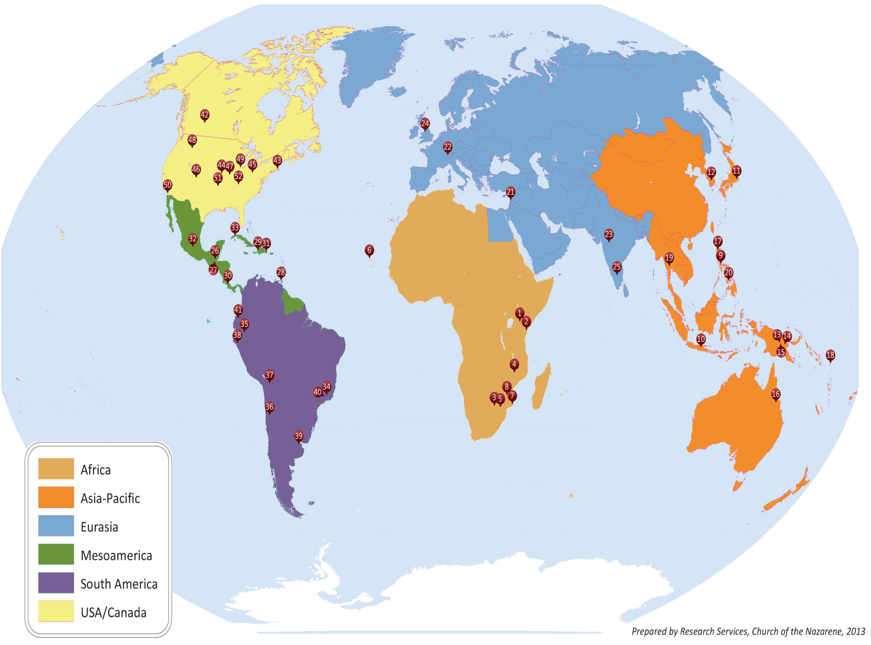

Slide 9
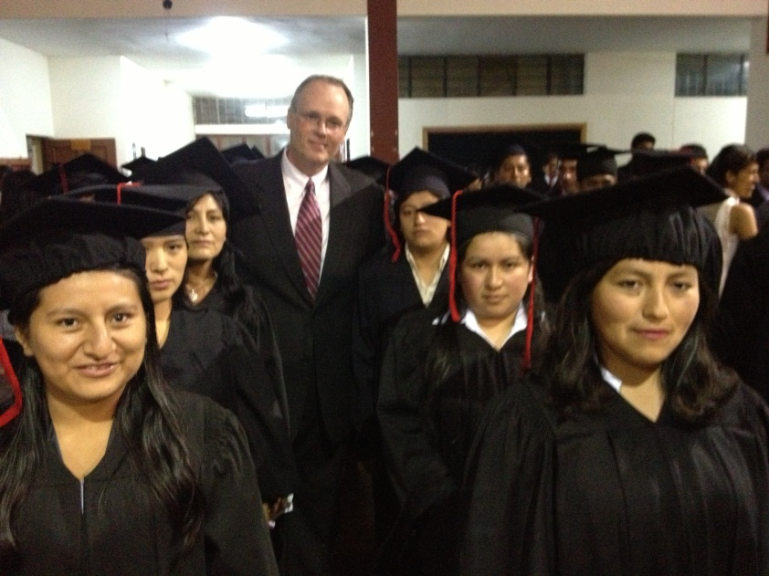
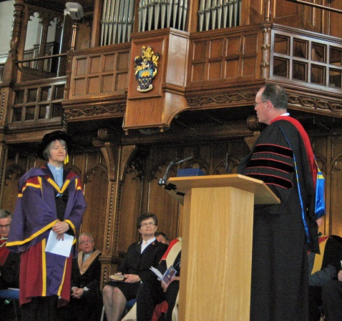
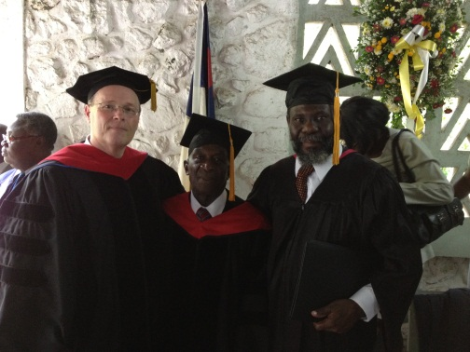
52 Colleges, Universities and Seminaries
120 World Areas
50,998 Students

Slide 10
 | 2005 | 2015
Schools | 56 | 52
Students | 49,597 | 50,890
Assets | $802,106,188 | $1,293,730,277
Church Support | $25,893,117 | $17,840,371

Slide 11
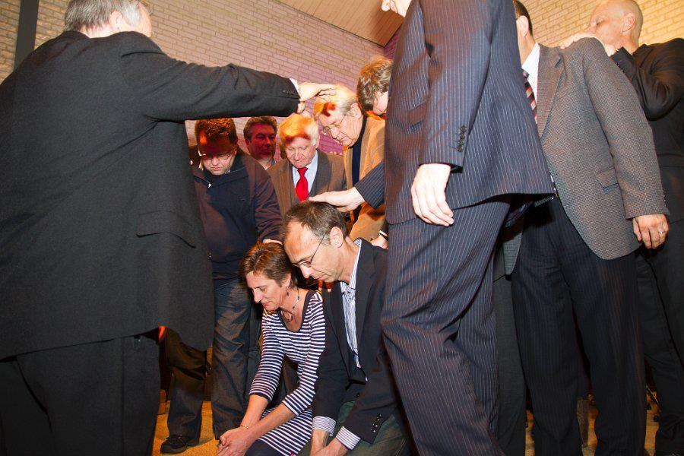
34,000 in ministerial preparation
18,000 ordained
52,000
ministers

Slide 12
 | 2005 | 2014
Ordained Elders | 14,364 | 17,395
Ordained Deacons | 623 | 836
District Licensed Ministers | 7,168 | 9,663
Total Credentialed Clergy | 22,155 | 27,894

Slide 13
GECD
Regional Education Coordinators
and Regional Councils
Regional Education Coordinators,
ICOSAC, RCOSACs
Global
Nazarene Education Consortium
(GNEC)
Quality & Missional
Reviews
Including Board Development
Calling of Clergy
IBOE Schools
Ordination
Education
Credentialing
Board Resources
Districts
Local Church
Global
Theology and Education Conferences
Continuing
Education
Advocacy
For Nazarene Education
Calling of Clergy Mentoring/License Resources for Pastor and Church Board
Encouragement,
Care, Nurture,
Advocacy,
Resourcing
Leadership
Development

Slide 14
Manual
- Be, Know, Do
- 4 C’s
- Partnership
Curse of Study
Define
Validate
Contextualize
Implement
Deliver
BGS/General Board
RECs/ICOSAC
REC/RCOSAC
REC/RCOSAC
Education Provider
Education Provider
Campus
Extensión
Online
Individualized

Slide 15
THE COURSE OF STUDY
There are many validated curriculums
but only one Course of Study
EDUCATIONPROVIDER
CURRICULUM
DEVELOPMENT
REGIONAL
APPROVAL
MINISTER IN
TRAINING
GEN. BOARD
and BGS
INTERNAT’L
APPROVAL
Notes:
Examples: ASSESSMENT SUMMIT and CLERGY RESTORATION or INTERVIEWING

Slide 16
Some of the Challenges & Opportunities Increasing role of decentralization Changes to school funding/business models Better connecting our schools & district boards Improving intentional leadership development Improving intentional theological coherence

Slide 17
Some of the Initiatives & Resources Education Systems Support Lifelong Learning Global Self-Registry Quality & Missional Reviews Theology Conferences & Strategic Consultations Identifying & Communicating Best Practices Review/Resource Course of Study Validation Process Review/Resource Annual Reporting Process Review/Resource Educational Institution Changes

Slide 18
Oher information, Questions, Discussion…

