Slide 1
NAZARENE INSTITUTIONS AND MISSION ALIGNMENT
Asia Pacific Educator's Roundtables Manila, The Philippines February 8 to12, 2016

Slide 2
PLNU with San Diego in the background

Slide 3
History and Education in perspective

Slide 4
History and Education in perspective
The history of the Church of the Nazarene is deeply intertwined with higher education and several institutions preceded the Church itself.
Our history of evangelism, missions, concern for the needs of others and our local communities often brought together church and education as places of service and outreach
Schools were begun to address specific needs and expectations about the future
Needs included preparation of ministers and missionaries, projected growth of the church, and for some institutions, the intention of preparing men and women for professions

Slide 5
History and Education in perspective (continued)
Visions were sometimes bolder than reality
Bresee's vision for a 3000 student, multi-schooled university in 1910
Some grew out of elementary and secondary schools with little higher education experience
NTS, NBC, MNU, MVNC as well as many global institutions were created by church action to meet perceived or identified needs in local and field contexts
Why was your institution begun and who were the key individuals in that beginning?

Slide 6
Relationship of the Church and Higher Education

Slide 7
Relationship of the Church and Higher Education
Both present from our earliest days
Higher education is often described as the church at work in education
Shared purpose of serving God and participating in God's purpose in the world
Distinctly different methods for each entity
Purposes are expressed differently and often have different audiences

Slide 8
Relationship of the Church and Higher Education (continued)
Conversations, topics, questions, and approaches are often different
Relationships between the church and higher education sometimes have tensions and misunderstandings which create mistrust
Dependency and needs sometimes shift across time
Vibrancy of the relationship requires continuous attention and effort
Aligning mission requires clear understanding of each other's unique purpose, the nature of the interrelated mission, and the active engagement among leaders of the church and higher education

Slide 9
Asia Pacific Educational Purpose

Slide 10
Asia Pacific Educational Purpose: Framing Questions
How do you define the mission of these in Asia Pacific?
The Church
Bible Colleges
Seminaries
Universities
Where do these missions intersect?

Slide 11
Asia Pacific Educational Purpose (continued)
In what ways are these intersections successful?
Where are the mismatches or challenges?
In your context, how important is it to have alignment between the institution and the church?
If important, what steps could be taken to more effectively align education and the church?

Slide 12
Key Factors for Institutional Planning
Accurate understanding of the "market needs" to be served by the institution. What is the problem you are trying to solve?
Clear and understood purpose (mission) of the institution. How are you going to meet these needs?
Necessary resources, structures, programs, and people to carry out the mission (This is the hard work of existence). What do you have to have to meet these needs?
Processes of regular assessment, analysis, and improvement. How will you keep on purpose and do so effectively?

Slide 13
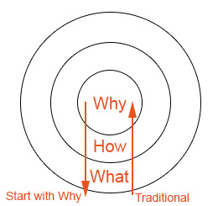
Recent Readings Informing PLNU Conversations
Start With Why by Simon Sinek
WHAT: Every single organization and company on the planet knows WHAT they do. They can easily describe the services they sell or their job function within that system.
WHY: Very few people or organizations can clearly articulate the WHY they do what they do. “WHY” is your purpose, cause or belief. Why does your organization exist and why should anyone care?
When most organizations or people think, act or communicate, they do so from the outside in. We say WHAT we do
Question: What was the “Why” that founded your institution and has there been drift from this?

Slide 14
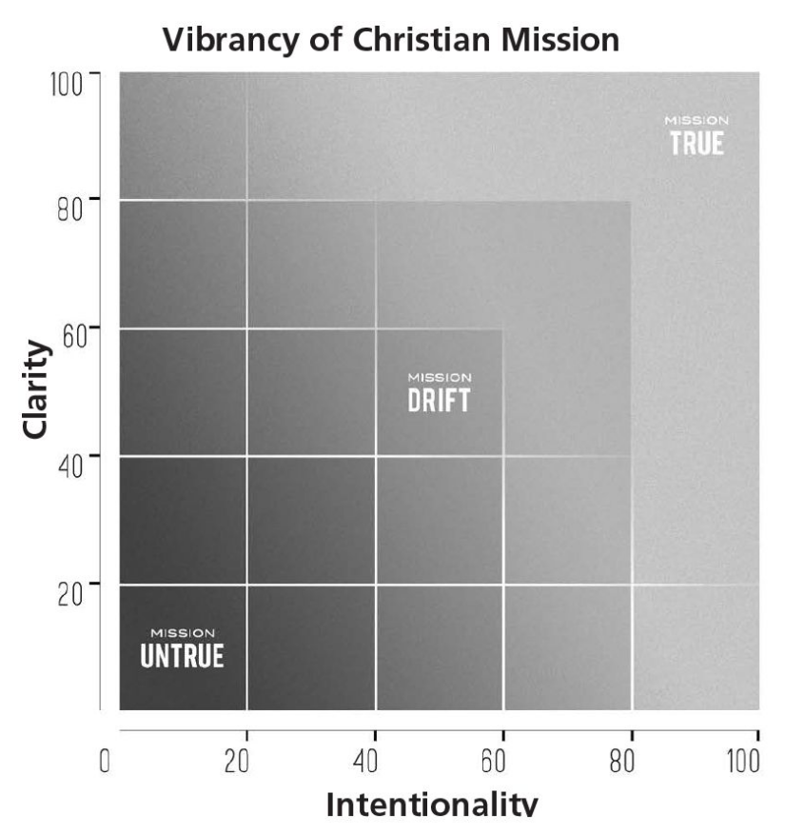
Recent Readings Continued...
Mission Drift
by Peter Greer and Chris Horst
Authors work for Hope International
Researched hundreds of faith based non-profit organizations
Found characteristics of Mission untrue and Mission true organizations
Found that Mission drift is the default that will occur unless intentional measures to prevent it are taken
Mission Drift unfolds slowly. Like a current, it carries organizations away from their core purpose and identity (rafting metaphor)
Two main characteristics to gauge mission drift are clarity and intentionality
Question: As you think of your institution’s mission, are you being clear and intentional in the role that you play? Where do you fit on the Mission True/Untrue continuum?

